Slide 1

america’s greatest county
Mayor Rogers Anderson
Notes:
© Copyright PresentationGo.com – The free PowerPoint library

Slide 2

Fallen But
Never Forgotten

Slide 3



THANK YOUR FIRST RESPONDERS
Notes:
© Copyright PresentationGo.com – The free PowerPoint library

Slide 4

Notes:
© Copyright PresentationGo.com – The free PowerPoint library

Slide 5




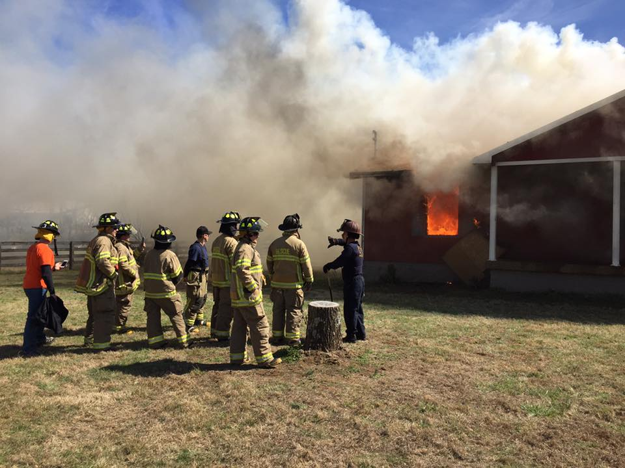
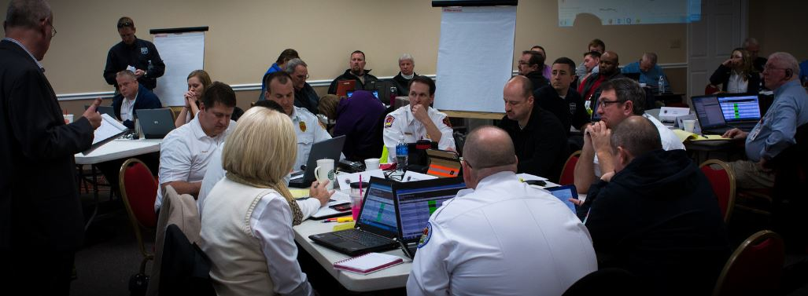
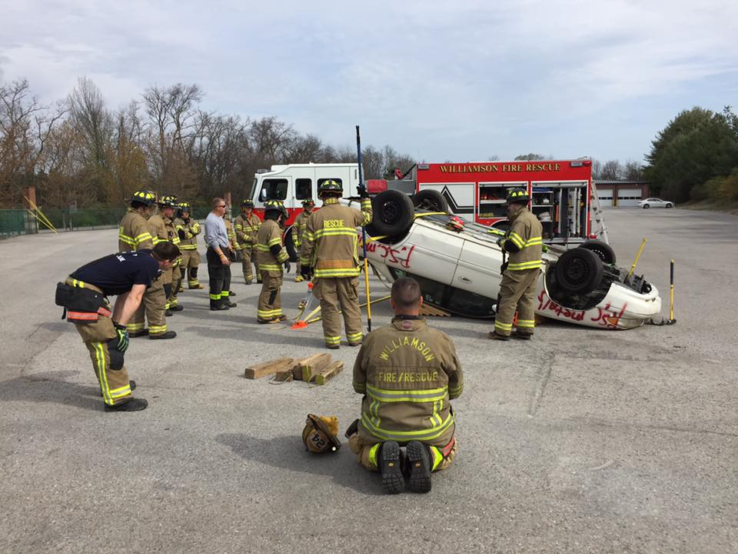
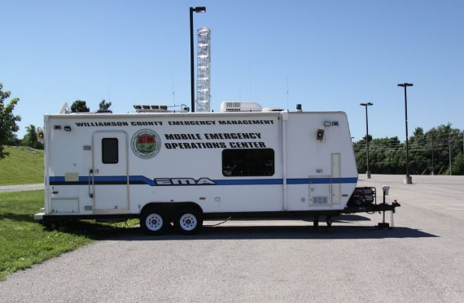
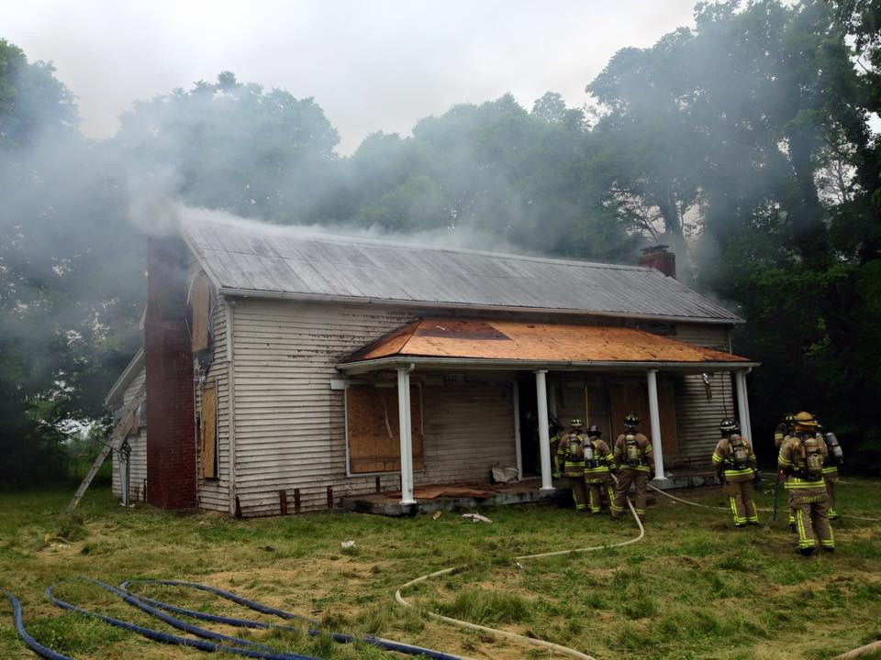
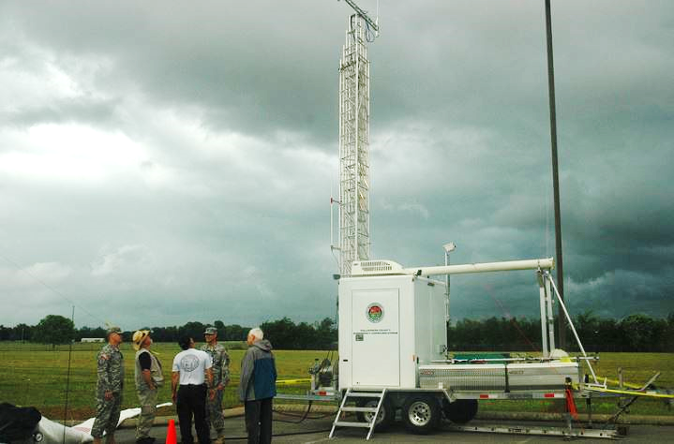

Slide 6

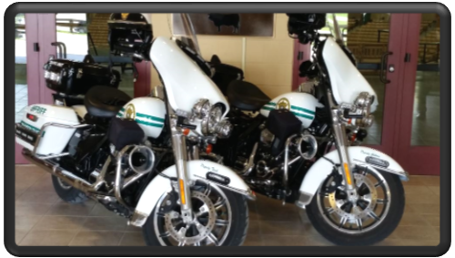
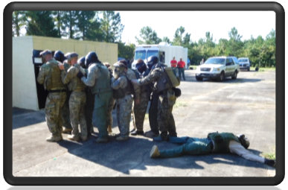

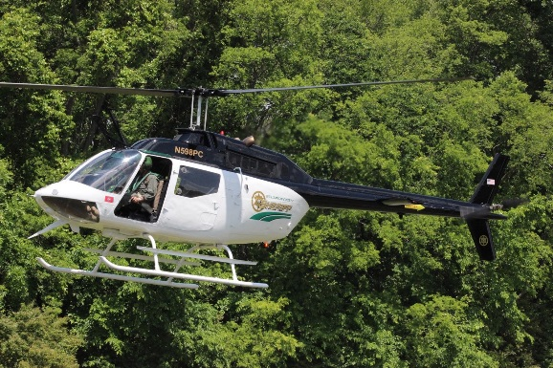

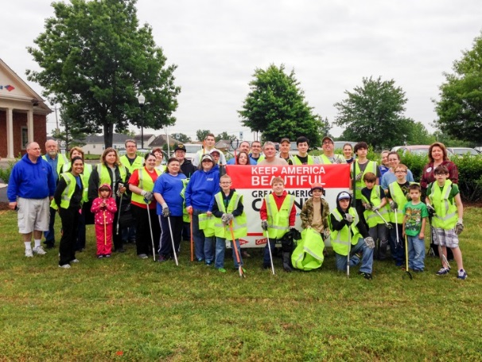



Slide 7

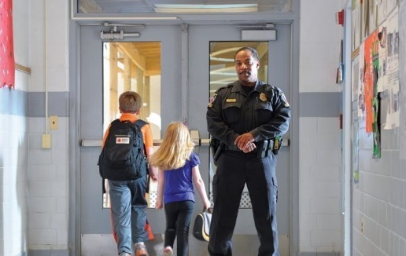




School Resource Officers
Elementary Schools
Middle Schools
High Schools
Including Franklin Special School District Schools

Slide 8
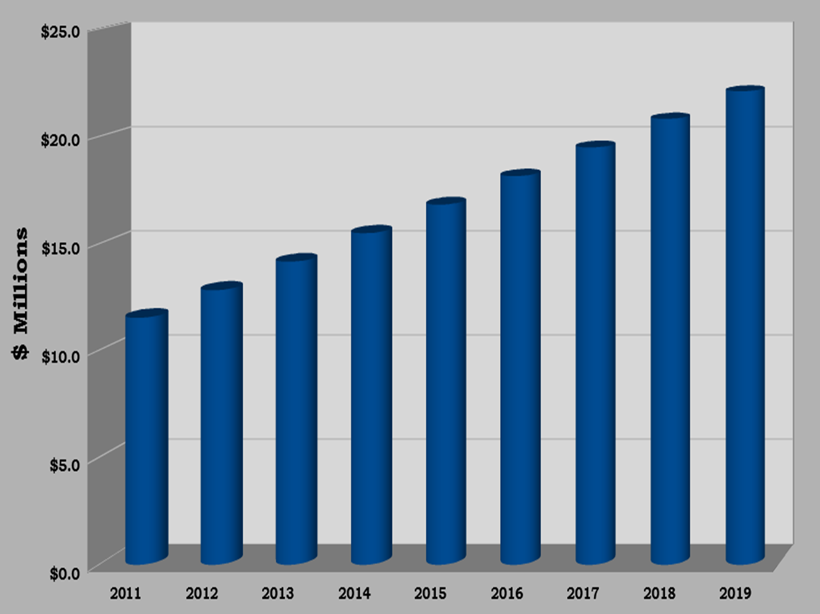
Sheriff’s Office
Funding
92.68 %

Slide 9

COMBATING
THE
OPIOID CRISIS

Slide 10
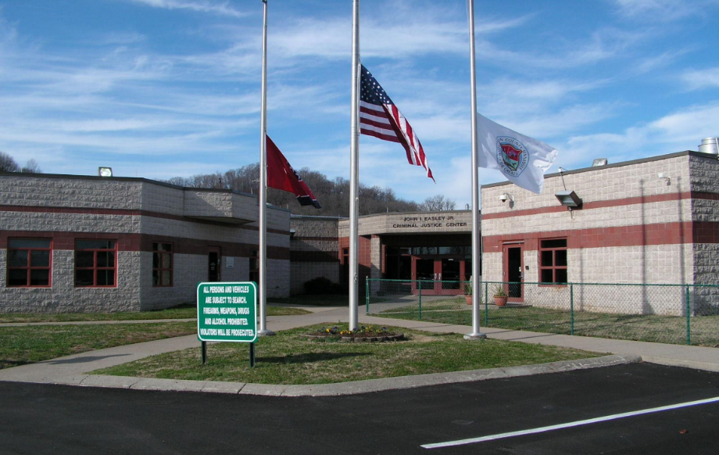

JOHN I. EASLEY CRIMINAL JUSTICE CENTER
CIRCA 1989
Adult Detention
Juvenile Detention
Male & Female
Sheriff’s Office Administration
Juvenile Court
Juvenile Court Judge & Administration
Juvenile Court Clerk Administration
Alternative Learning Center
Magistrates – 24/7

Slide 11
“TRIPLE J” TASK FORCE
JUVENILE - JUDICIAL - JAIL
20 - 25 Year Growth Needs
Adult Detention (Jail)
Jail Administration
Sheriff’s Office Administration
Juvenile Court Rooms
Juvenile Detention
Juvenile Court Judge & Administration
Juvenile Court Clerk & Administration
Alternative Learning Center
Magistrates – 24/7

Slide 12
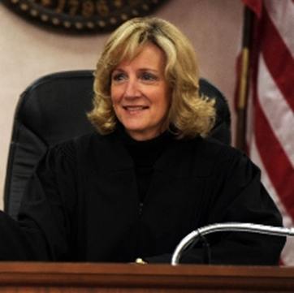
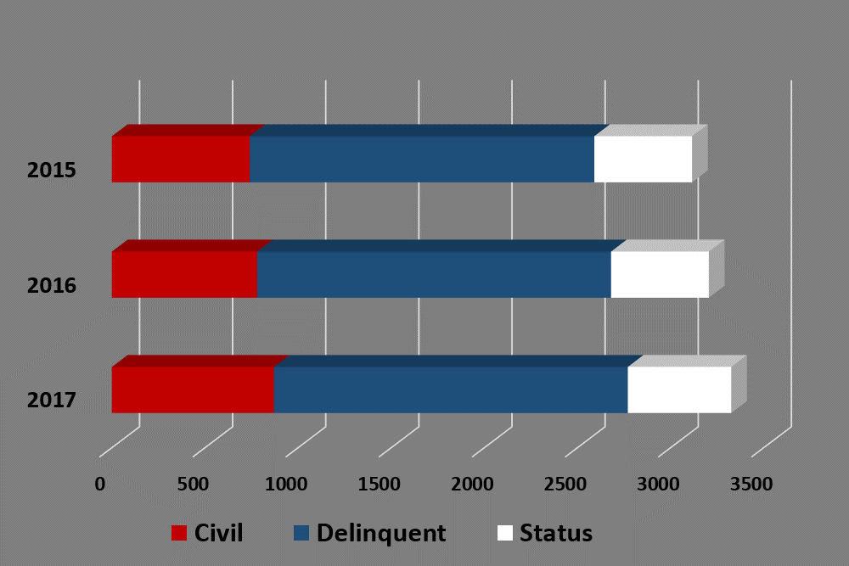


Juvenile Court Cases
Juvenile Court Judge,
Sharon Guffee

Slide 13
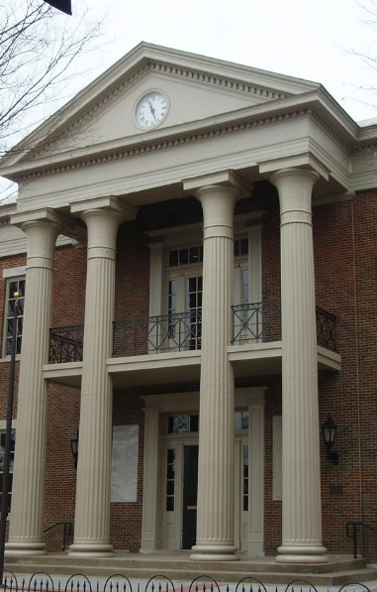
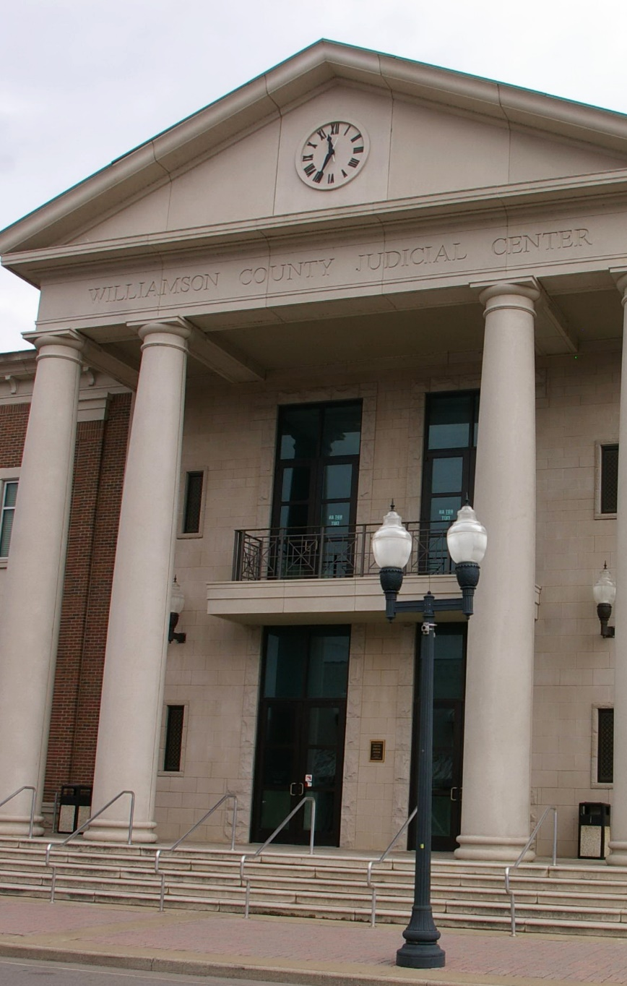

21st Judicial District
Courtroom Space Needed

Slide 14


Public Building
Authority
$aving Us Money

Slide 15
Williamson County Schools Budget Increases
$12.8 Million Increase
from 2018 - 2019

Slide 16
10 Year Budget Schools and Total Other
Budget Year End | Total Expenditure | Total Schools | Percent Schools | Total Other | Percent Total
2009 | $ 348,005,454 | $ 219,415,731 | 63.05% | $ 128,589,723 | 36.95%
2010 | $ 347,818,498 | $ 222,761,458 | 64.05% | $ 125,057,040 | 35.95%
2011 | $ 362,914,734 | $ 233,560,823 | 64.36% | $ 129,353,911 | 35.64%
2012 | $ 388,030,541 | $ 248,809,276 | 64.12% | $ 139,221,265 | 35.88%
2013 | $ 397,952,747 | $ 257,723,536 | 64.76% | $ 140,229,211 | 35.24%
2014 | $ 434,850,406 | $ 272,910,780 | 62.76% | $ 161,939,626 | 37.24%
2015 | $ 440,951,983 | $ 287,586,446 | 65.22% | $ 153,365,537 | 34.78%
2016 | $ 472,785,245 | $ 306,896,346 | 64.91% | $ 165,888,899 | 35.09%
2017 | $ 515,057,658 | $ 339,884,144 | 65.99% | $ 175,173,514 | 34.01%
2018 | $ 557,746,817 | $ 356,662,975 | 63.95% | $ 201,083,842 | 36.05%
2019 | $ 568,424,146 | $ 371,057,893 | 65.28% | $ 197,366,253 | 34.72%
2019 – With Debt | $ 568,424,146 | $ 422,374,893 | 74.31% | $ 146,049,256 | 25.69%

Slide 17

YOU
MAKE A DIFFERENCE!
2018-2019
Budget Committee
Paul Webb, Chairman
Judy Herbert
Bobby Hullett
Todd Kaestner
Rogers Anderson, County Mayor
Property Tax
remains
The Same!
$2.15
County Wide

Slide 18

7th District – Tom Bain
5th District – Lewis Green, Jr.
8th District – Jack Walton, Jr.
10th District – Houston Naron, Jr.

Slide 19


…because Pets are Family too.

Slide 20
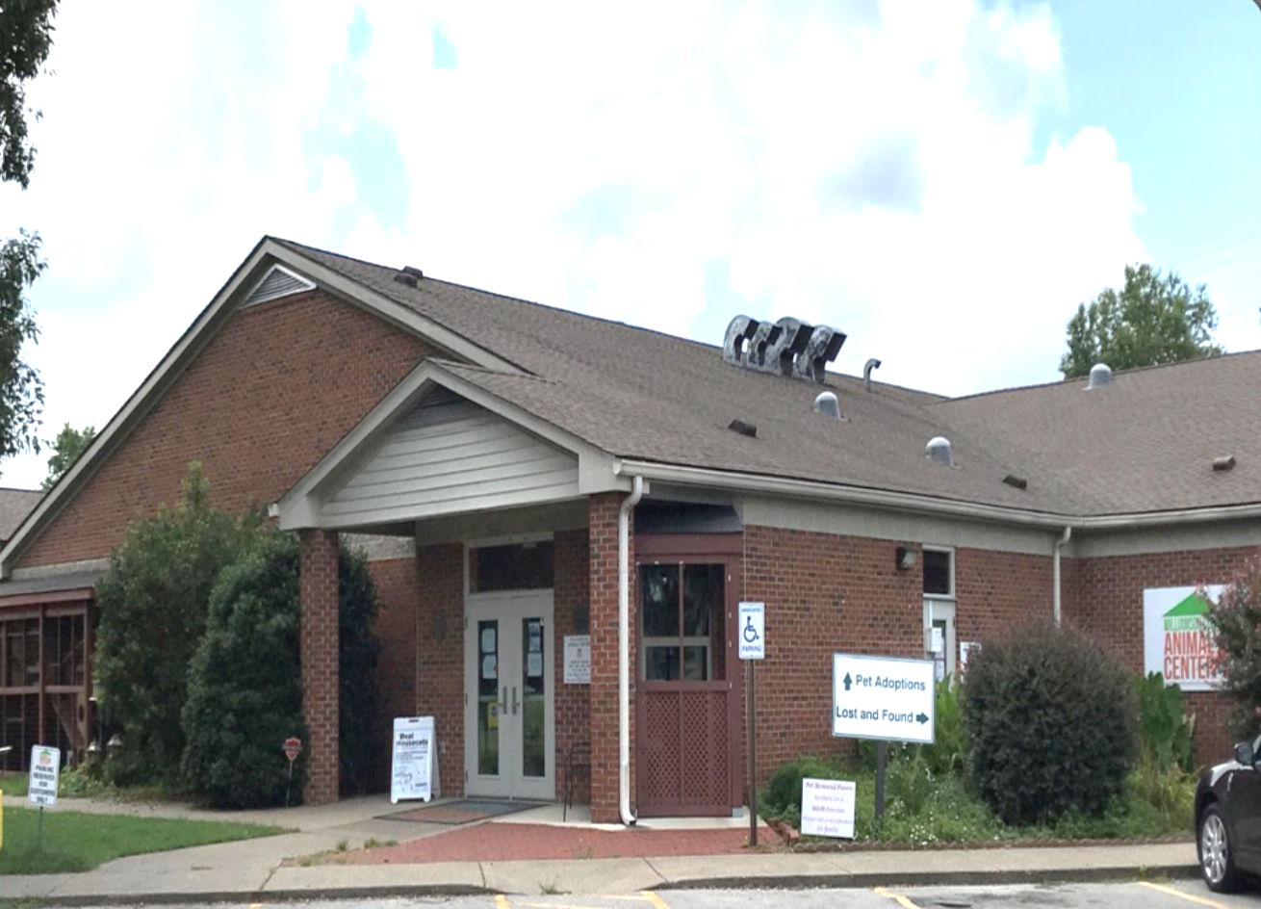

Notes:
© Copyright PresentationGo.com – The free PowerPoint library

Slide 21





97%
SAVE RATE
Save
Lives

Slide 22




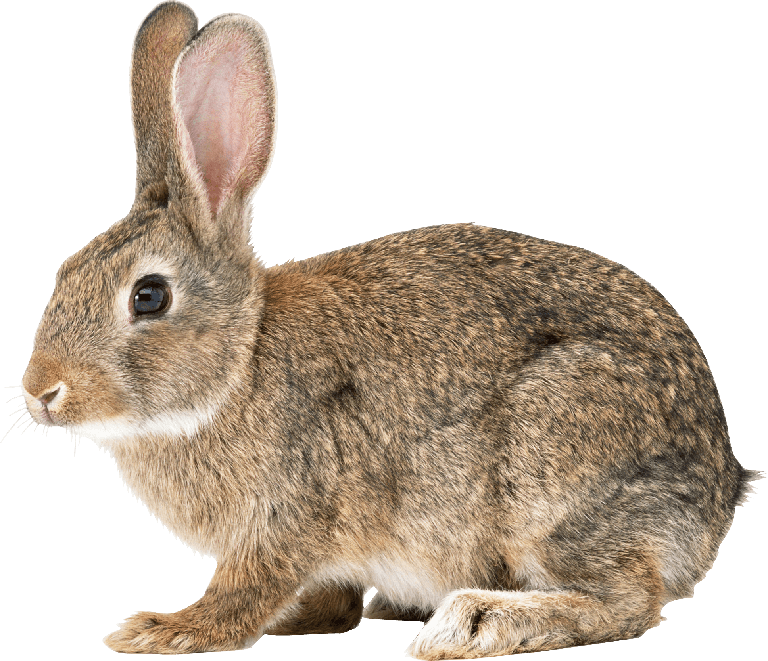
It’s not just rabbits who multiply like rabbits
Spay or Neuter Your Pets.
Help Stop Pet Overpopulation.

Slide 23
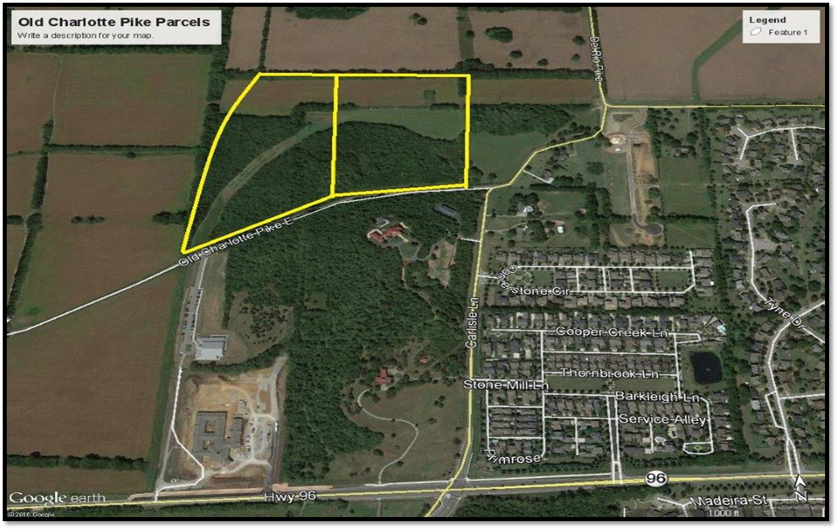
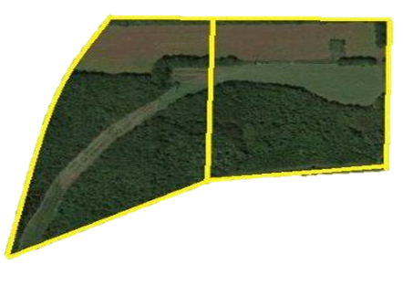
New Location

Slide 24



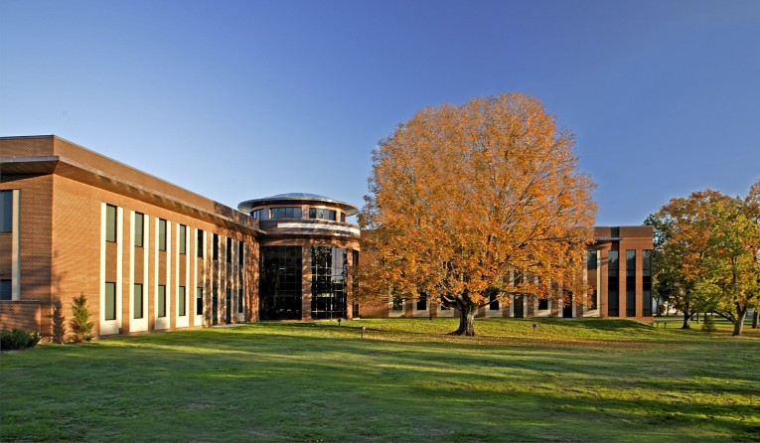
WILLIAMSON COUNTY PUBLIC LIBRARY
Learning Lab
Open for Business

Slide 25


Property
Maintenance
106
Facilities
$6.6
Million

Slide 26


Slide 27


OUR
FUTURE
MATTERS

Slide 28
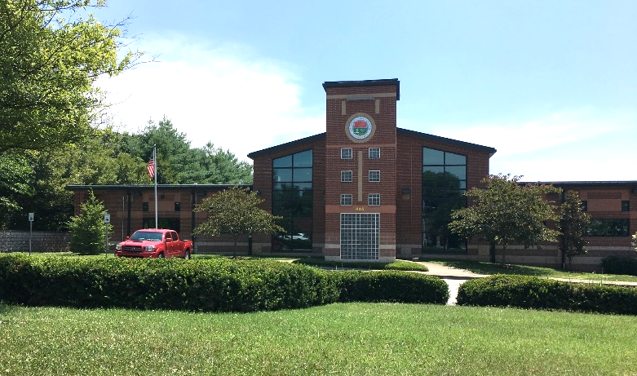

WC Election Commission Future Location - Downs Boulevard

Slide 29
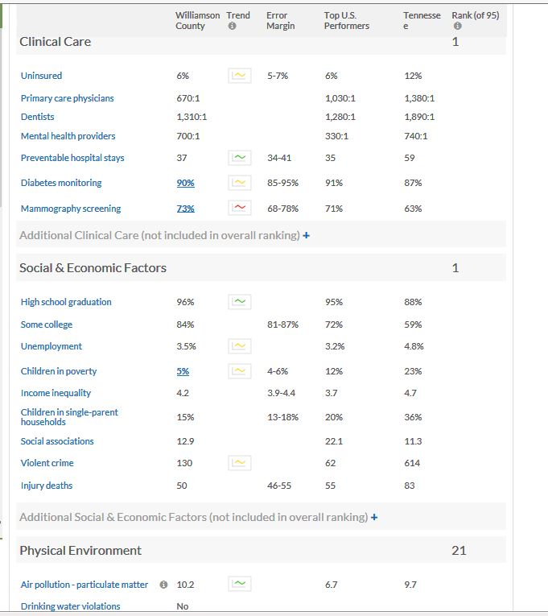
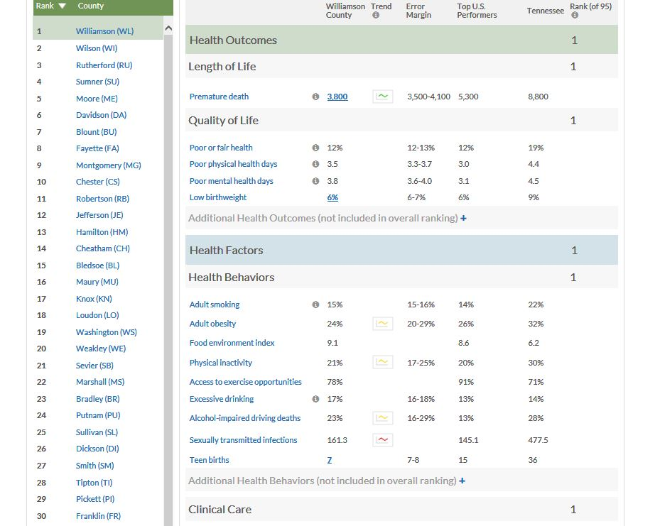
Williamson County
Health Outcomes Ranking
Social & Economic Factors
Clinical Care
Length of Life
Ranked
#1
in Tennessee
For…
Health Factors
Healthy Outcomes
Health Behaviors
Quality of Life

Slide 30
INVENTORY CHANGE 2010 TO 2018
TAX YEAR
# of Parcels
TOTAL VALUE
TOTAL COMMERCIAL
2010
3116 PARCELS
$4,692,273,561
2018
3254 PARCELS
$9094,274,500
4.4%
93.8%
TOTAL RESIDENTIAL
2010
70439 PARCELS
$21,715,828,655
2018
83374 PARCELS
$36,208,829,350
18.4%
66.7%
TOTAL INVENTORY 2018
Commercial & Residential
$45+ BILLION
APPRAISED VALUE

Slide 31

Just Released……
US population boom: Fastest growing county in every state
Tennessee: Williamson County
2010-2017 population change: +22.9% (184,130 to 226,257)
2010-2017 population change, Tennessee: +5.7% (6,355,882 to 6,715,984)
2010-2017 population change due to migration: +35,034
2017 unemployment: 2.7% (Tennessee: 3.7%)

Slide 32
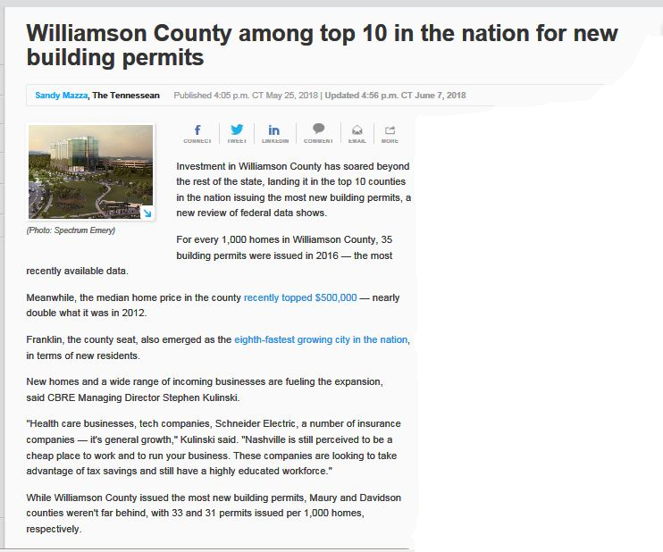


Slide 33
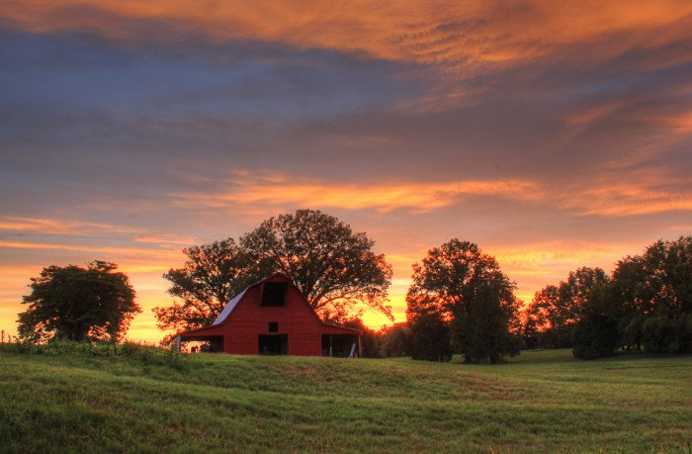

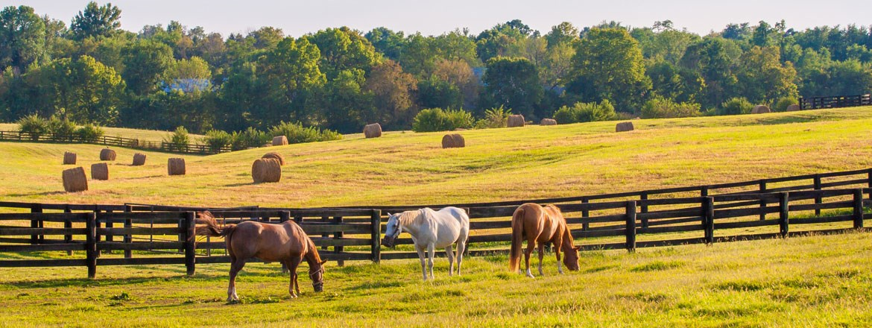
Farms & Natural Lands

Slide 34


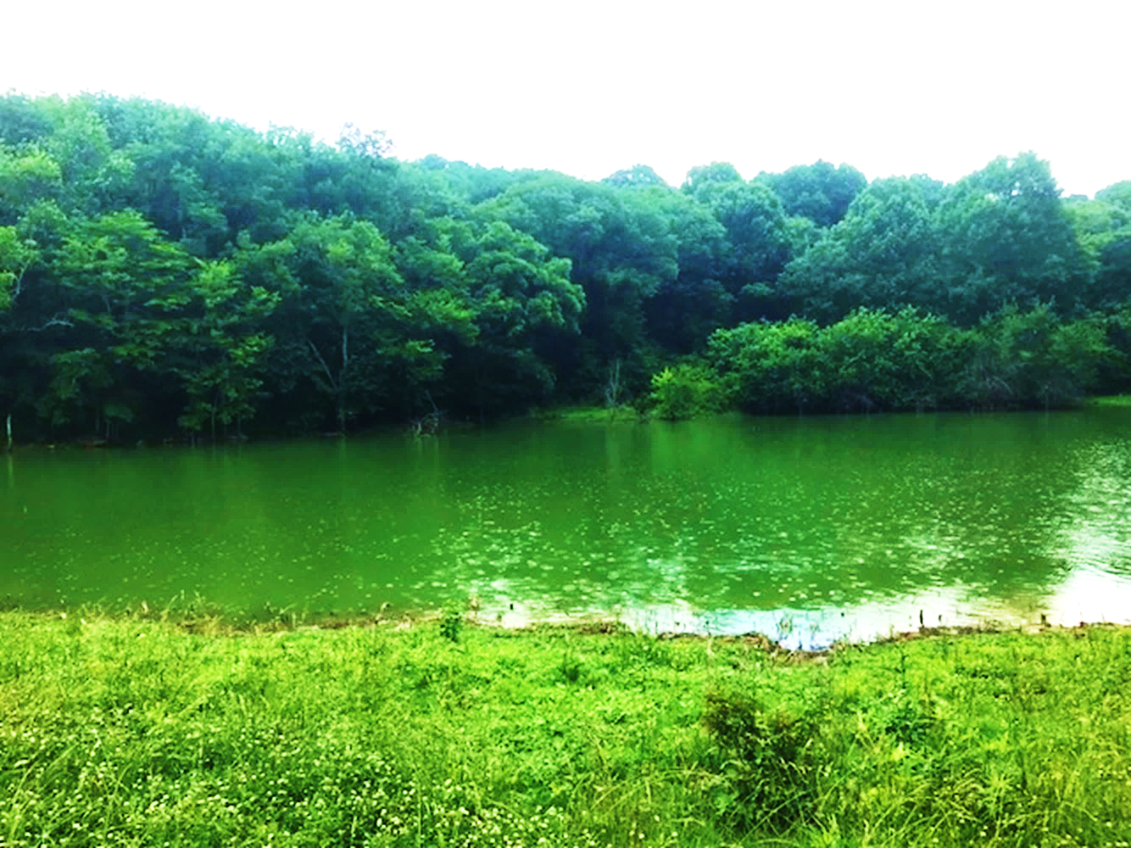
245 Acres

Slide 35
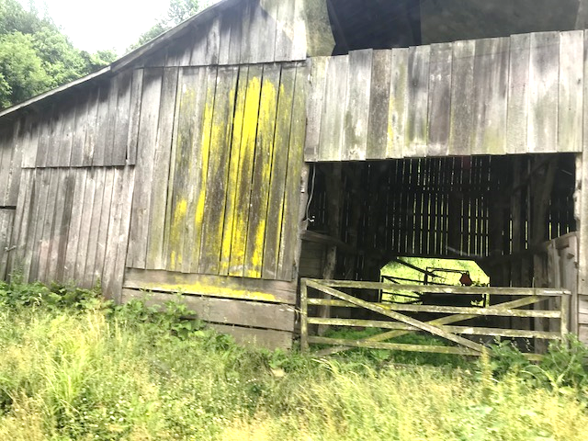
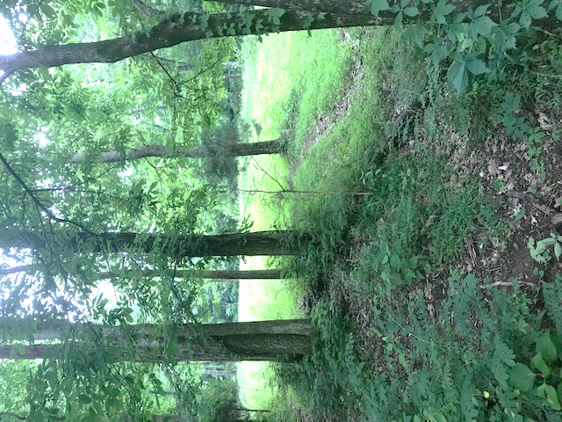

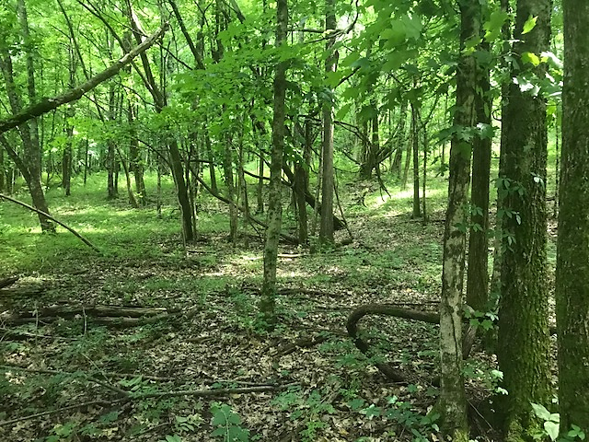
PEACOCK HILL NATURE PARK
Thank You
OGILVIE FAMILY

Slide 36

5th
Place in
America
Named
Happiest
-Smart Assets

Slide 37
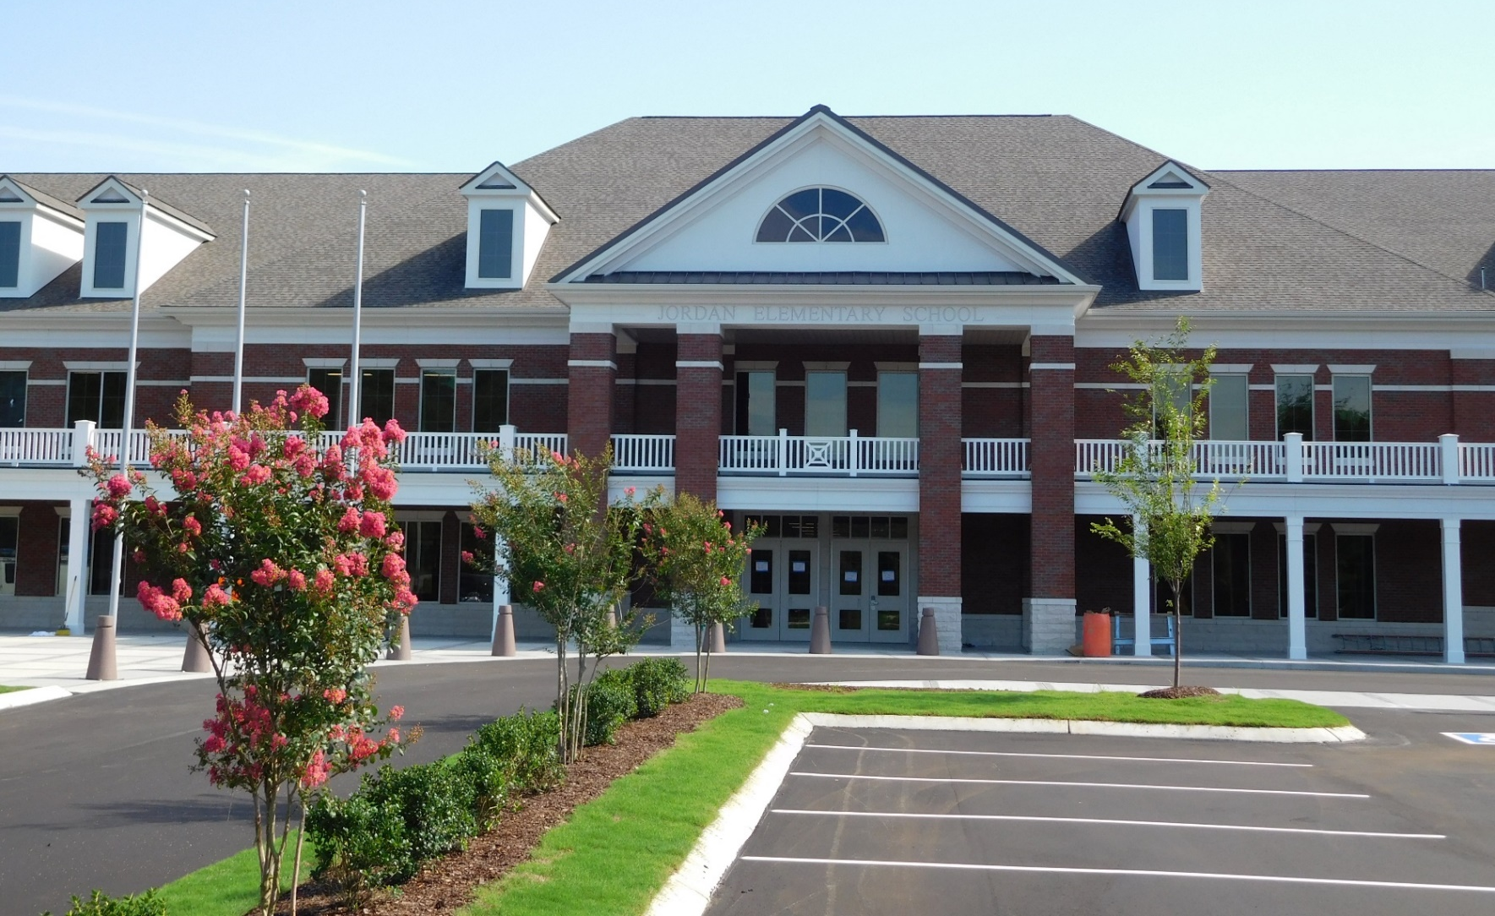
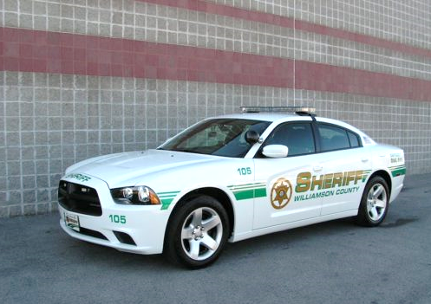
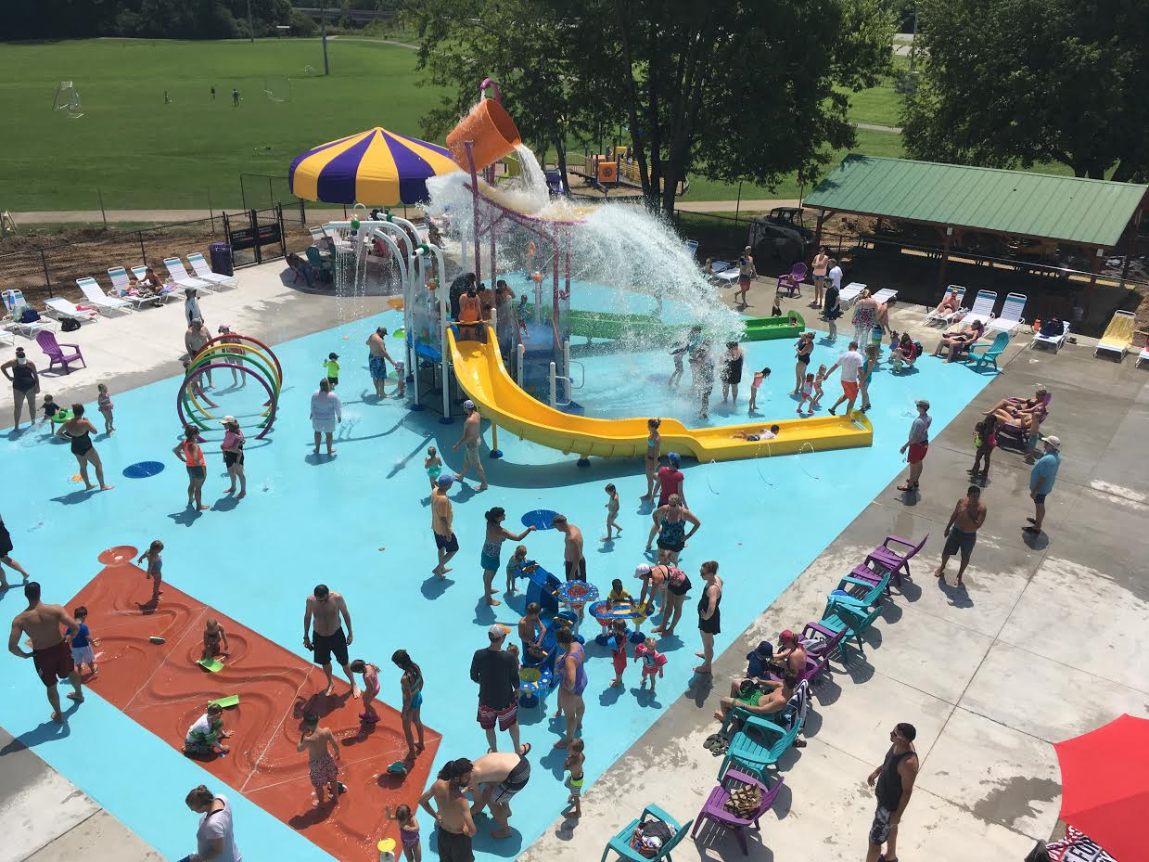
Award
Winning
Parks & Recreation
Facilities
Excellent
Law
Enforcement!
Great
Schools!

Slide 38
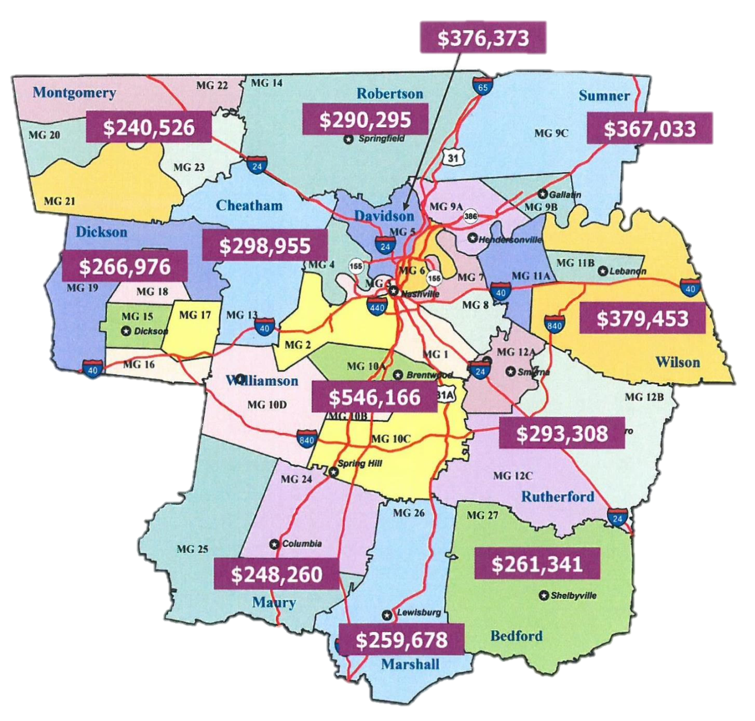

June 2018 New Home Averages

Slide 39








6th
^{OVERALL IN THE STATE}
^{In} 2016
RANKED
Williamson County!!!
$427.25 Million

Slide 40
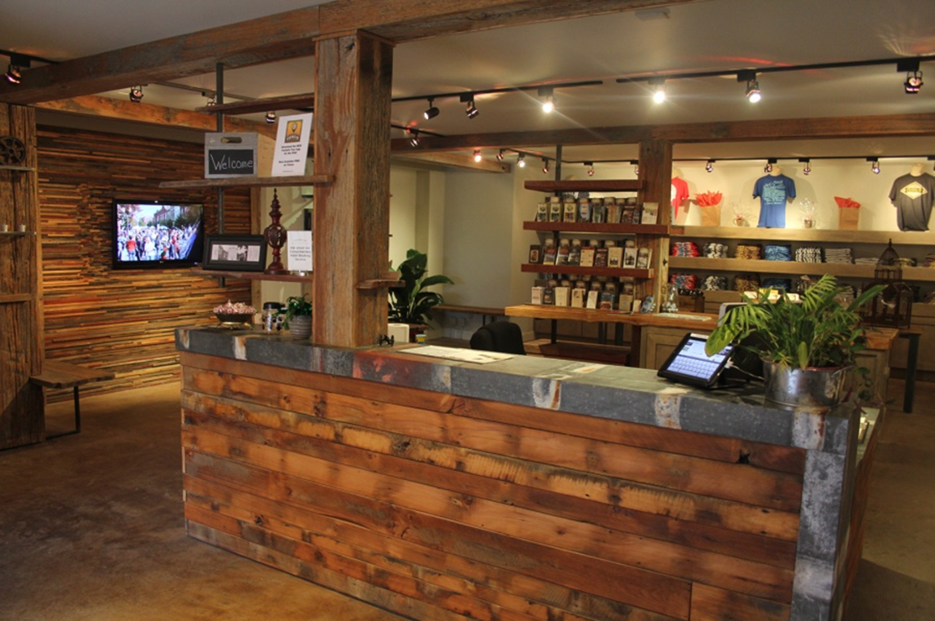
Welcome, Y’all!
We’re Happy to Have You…..
all 1.5 million of ya!

Slide 41

Aaa Bond Rating

Slide 42
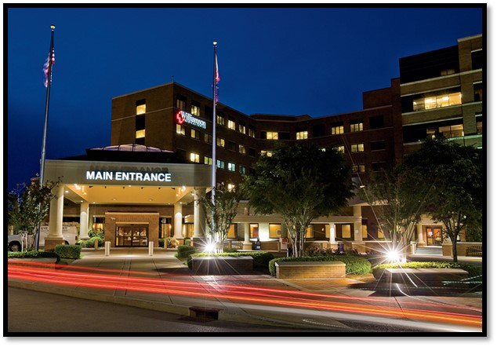
Williamson Medical Center

Slide 43
Bone and Joint Institute of Tennessee

Slide 44
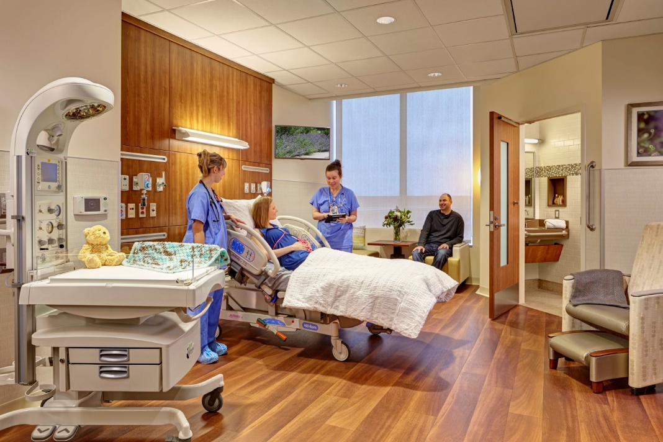
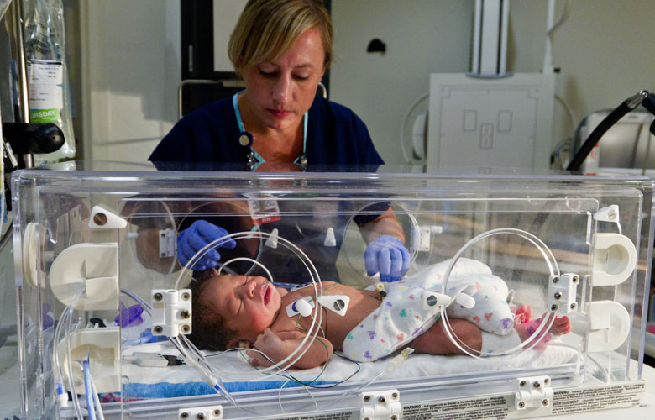

Facility Upgrades 2018

Slide 45

COMMUNITY
UNITY
VILLAGE
warmth
DEVELOPMENT
GROWTH
LIFE
VOICE
GIVE
HEART
SUCCESS
WORK
SOCIAL
VOLUNTEER
HOPE
CARE
CHANGE
PROFESSIONALS
TEAMWORK
IDEAS
DONATIONS
HUMANITARIAN
GROWTH
NON PROFIT
SAFE
KIND
ADULTS
TOGETHER
EDUCATION
FOOD
HELP
PEOPLE
TRAINING
LIFE
STAFF
FRIENDSHIP
ASSISTANCE
FAMILY
COMMUNICATION
CHANCES
DIVERSITY
MONEY
OVERCOME
KINDNESS
RELIEF
GIVING
COUNCIL
FAITH
OPPORTUNITIES
HAPPY
NETWORK
THANKFUL
JOBS
CHILDREN
NEEDS MET
GRATITUDE
EFFORT

Slide 46
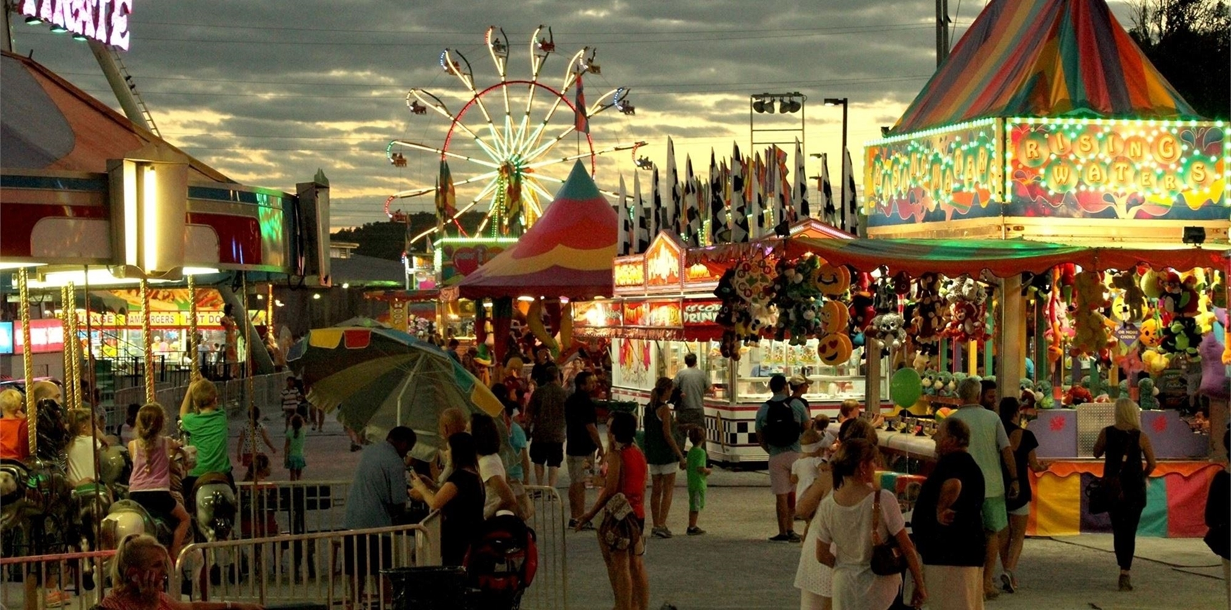




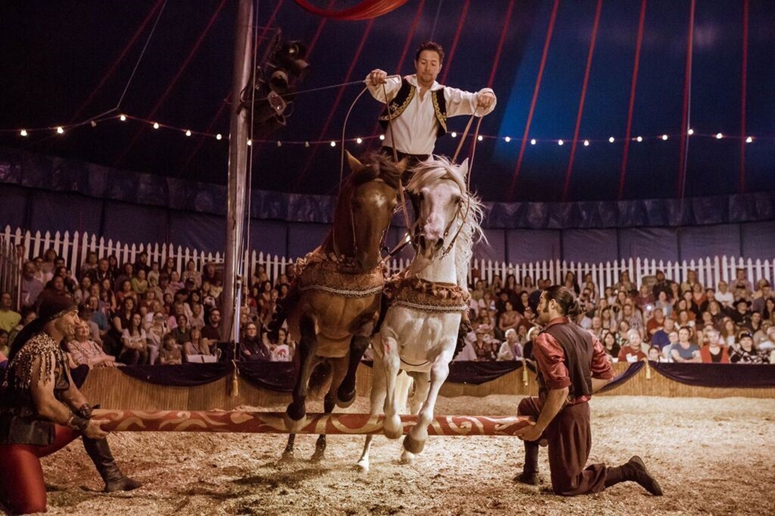

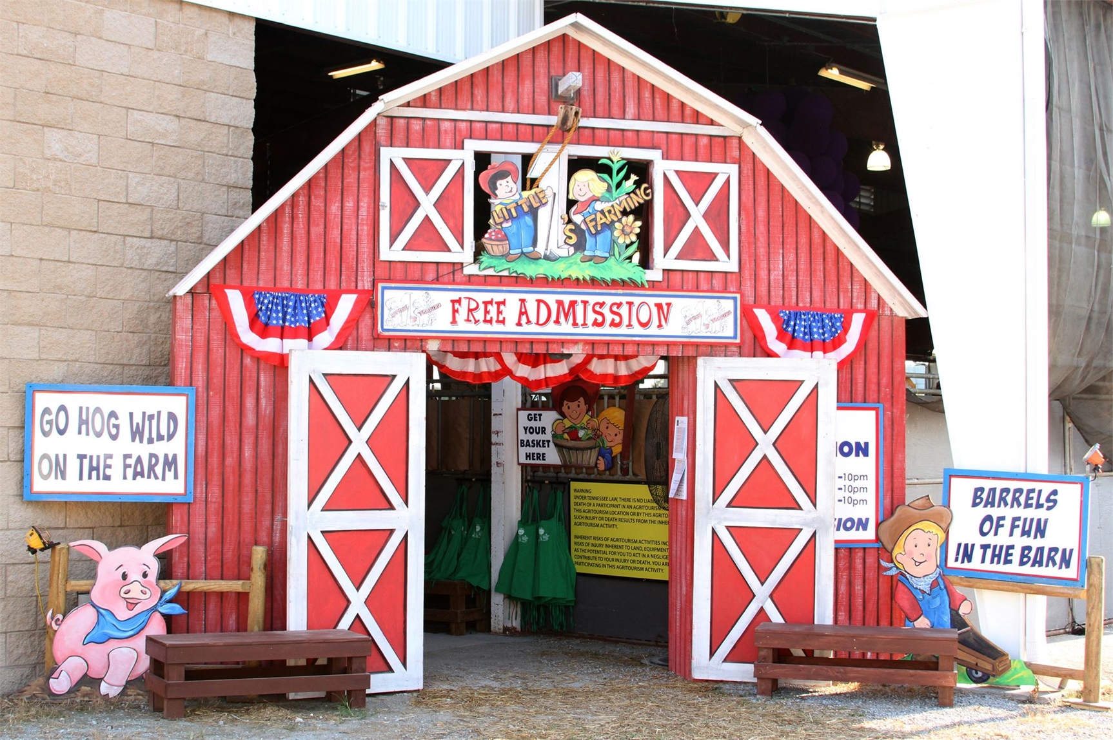

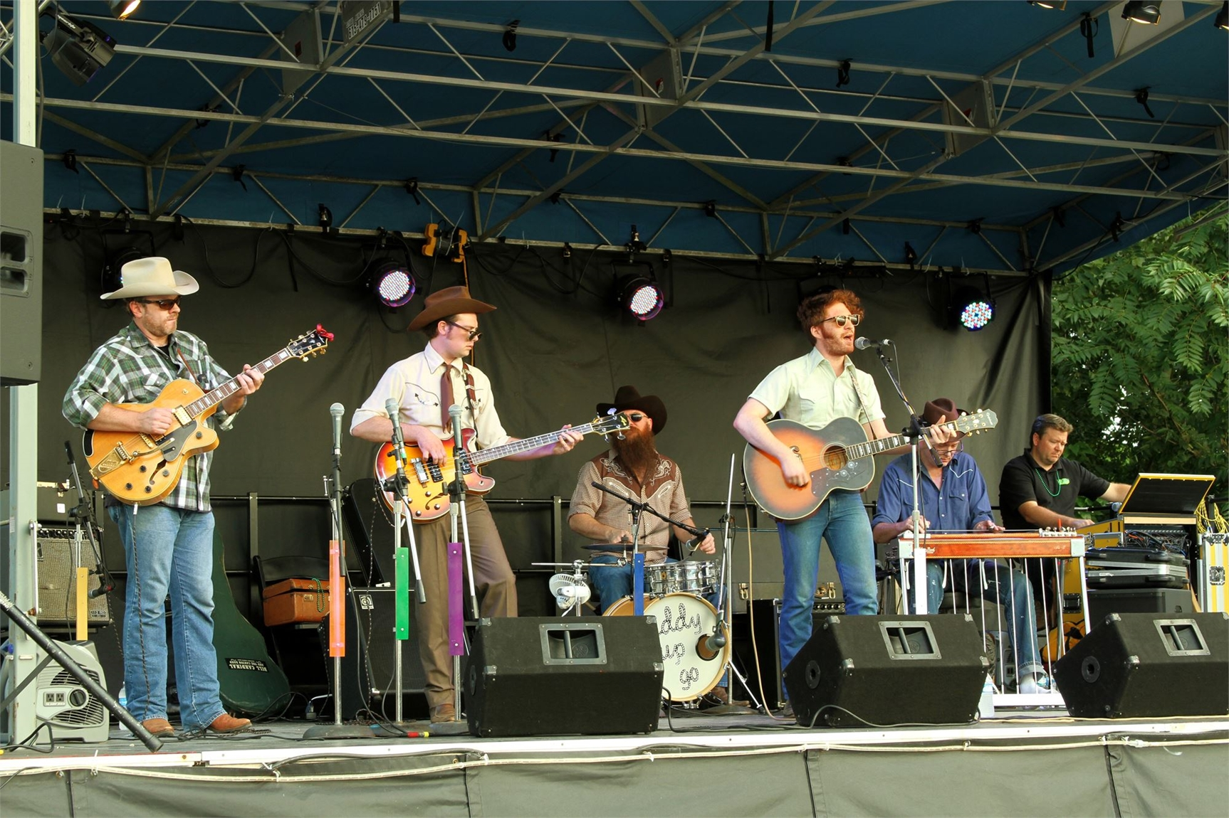

Slide 47

9 Days of Fun
Starts the First Friday in August!
www.WilliamsonCountyFair.org

Slide 48

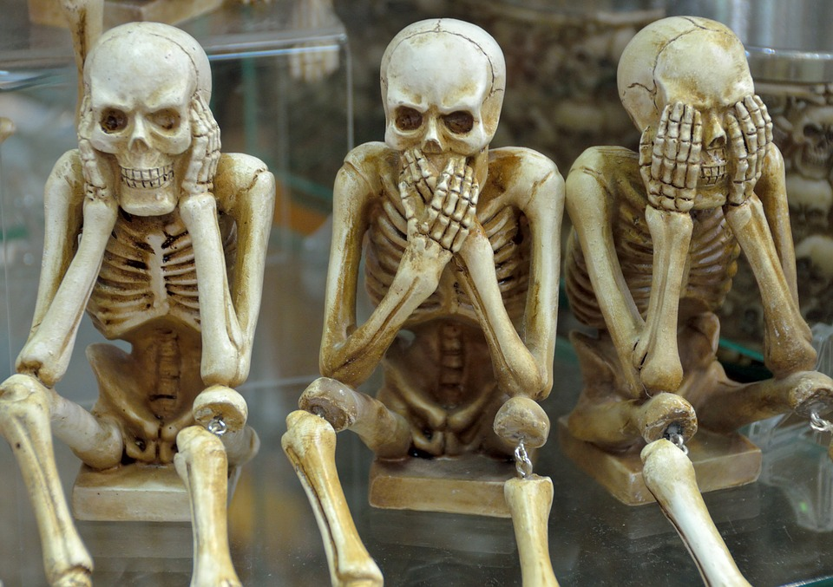

I HOPE YOU FOUND THIS HUMER-OUS….

Slide 49
america’s greatest county
Notes:
© Copyright PresentationGo.com – The free PowerPoint library

